Slide 1
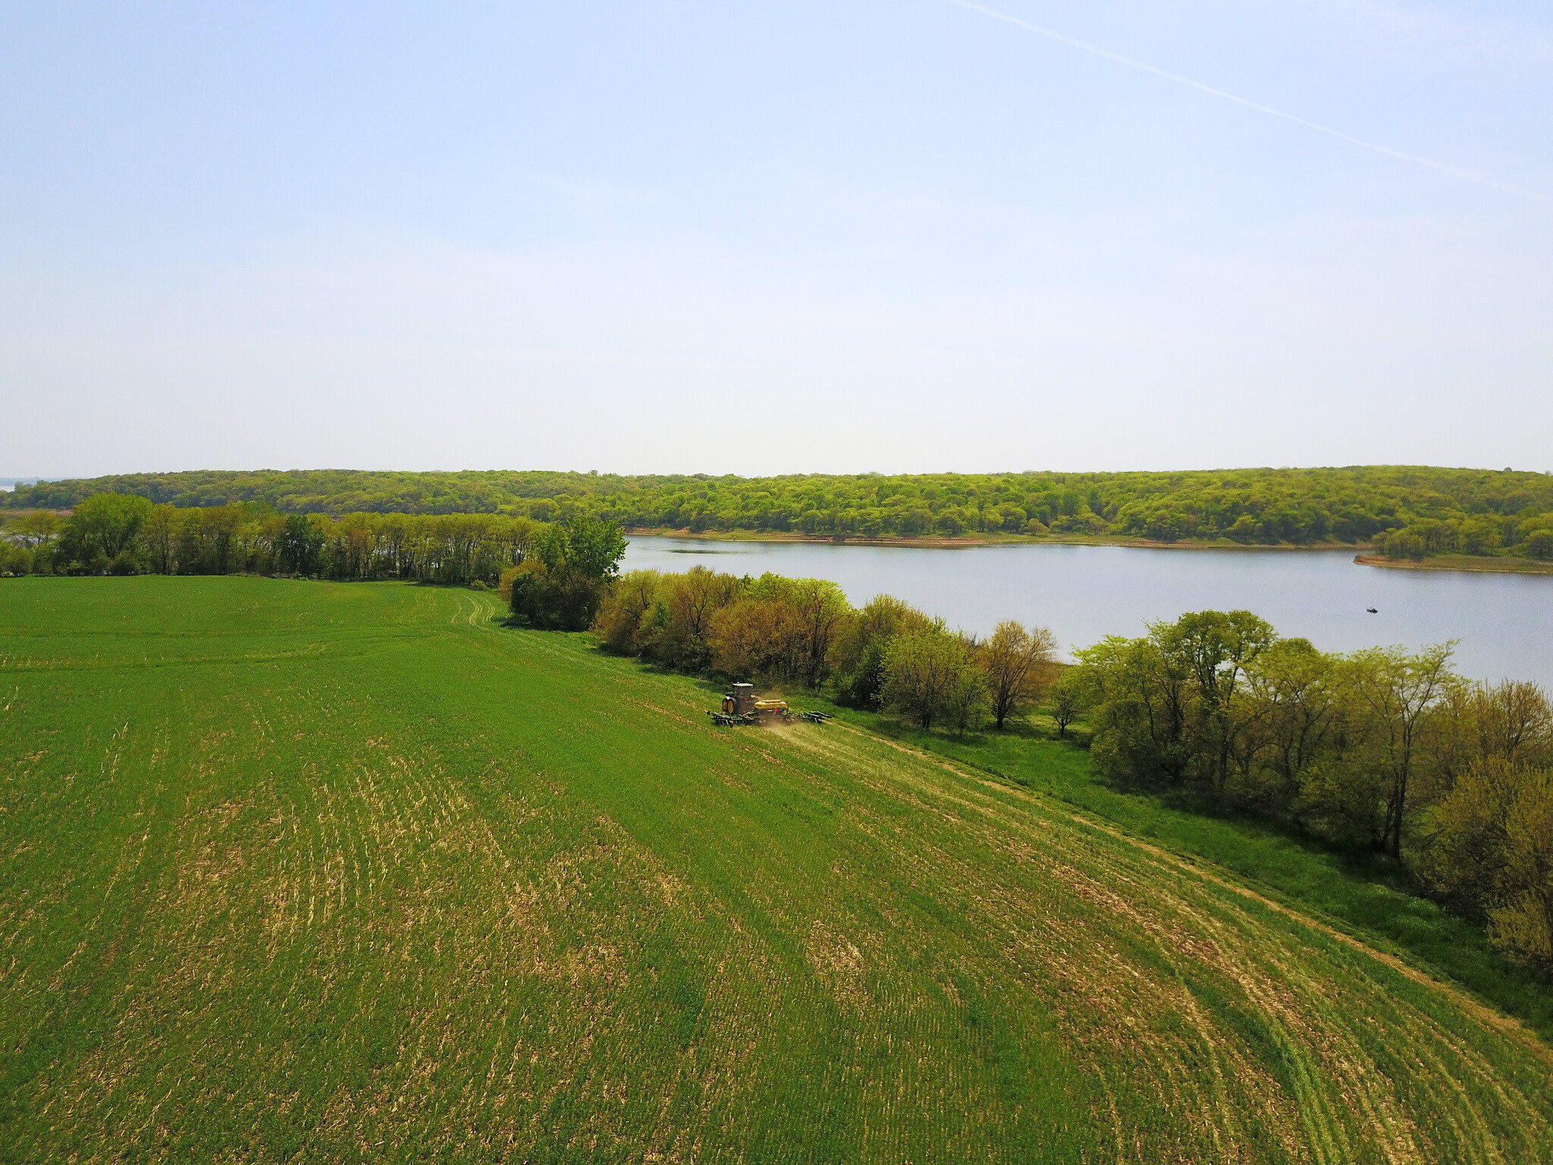



Slide 2
Who we are

Slide 3
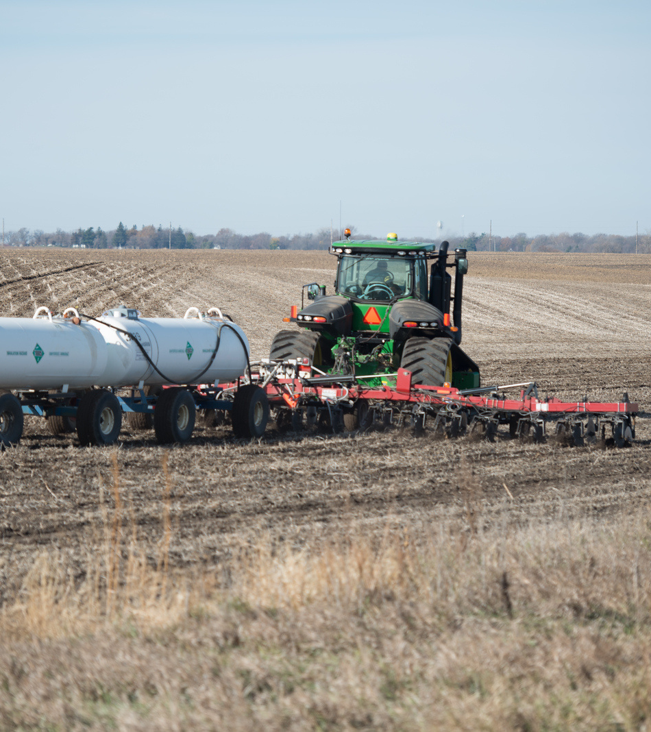

ACWA at a glance
Agriculture’s Clean Water Alliance (ACWA) is a non-profit association of ag retailers and support companies across the state of Iowa.
We are direct competitors, yet we have a mission to help farmers improve their agronomic performance while supporting environmental improvement efforts. ACWA is funded by member dues based on a percentage of our annual nitrogen fertilizer sales.

Slide 4



Our Three Core Pillars
Defined in our strategic plan
We are...
We are...
We are...
Data driven
Leaders
Farmer trusted
Learn more

Slide 5
Our Three Core Pillars
Science to Solutions
  Water monitoring - ACWA evaluates and analyzes water samples from rivers and tributaries as well as tile lines. This is used to determine project areas, watershed planning, and baseline levels that we can improve one.
  Soil health & water quality tracking - ACWA has the expertise and boots on the ground to monitor the impacts of both in-field and edge-of-field water quality practices.
  Outreach - What we learn isn’t just for us. Our partnerships statewide allow us to reach large audiences.
We are...
Data driven
Learn more

Slide 6
Our Three Core Pillars
Leader and Advocate
  Unity - ACWA members may be competitors in sales and customers, but we are united in promoting conservation on agricultural lands.
  Influence - ACWA has a credible and influential voice when it comes to speaking to farmers, landowners, state and national agencies, and leaders in ag & conservation. We also listen.
  Projects - ACWA has raised millions of dollars for ag-led conservation from third-party funders like IDALS’ Water Quality Initiative, USDA’s Regional Conservation Partnership Program, and the Walton Family Foundation
We are...
Leaders
Learn more

Slide 7

Our Three Core Pillars
Innovate and Sustain
  Conservation Agronomist Network - ACWA is the inventor, strategist, and innovator of this network that is making waves statewide. Conservation Agronomists help farmers with one-on-one advice for making sustainability profitable.
  Soil health - Through ACWA’s statewide reach of ag retailers, we promote soil health practices like cover crops and no-till.
  Water Quality - ACWA also promotes science-based practices at the edges of fields, such as bioreactors, saturated buffers, and wetlands. In fact, ACWA installed the first large, on-farm bioreactor leading to the current science-based practice standard for all farmers nationwide.
We are...
Farmer trusted
Learn more

Slide 8
History of ACWA
MILLIONS RAISED
through state, federal, and private contributions
1999
2002
2008
2018
2021
TODAY
Founding of ACWA with mission based in Raccoon River
Water monitoring program leads to ACWA’s first watershed plan
ACWA expands to Des Moines River Watershed
North Raccoon Farm to River Partnership begins
ACWA expands statewide
Conservation Agronomist model formalized
22 members-strong, including some original members
Learn more

Slide 9
What we do

Slide 10
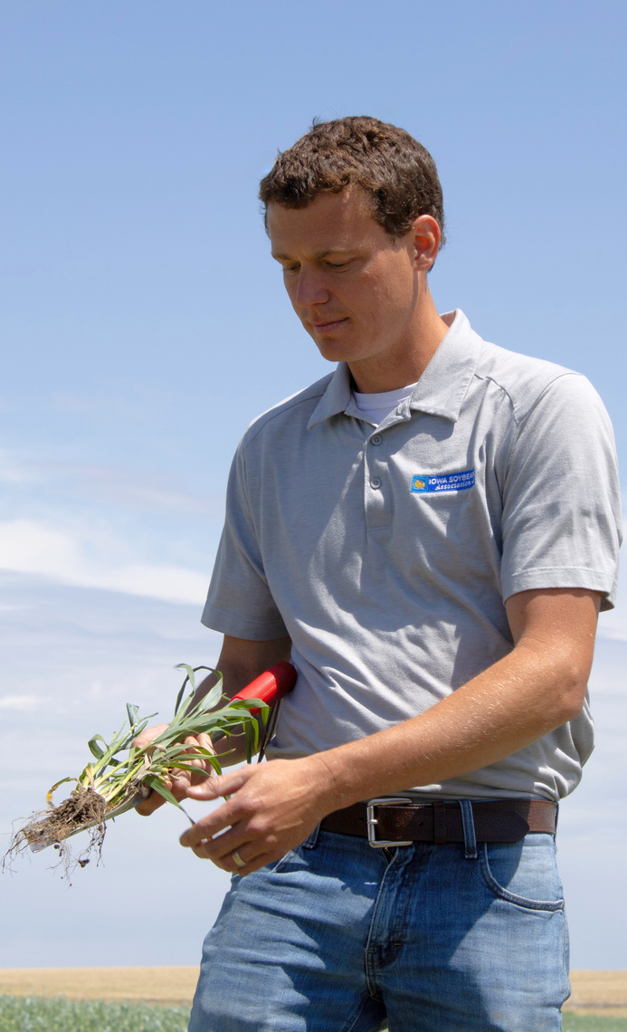
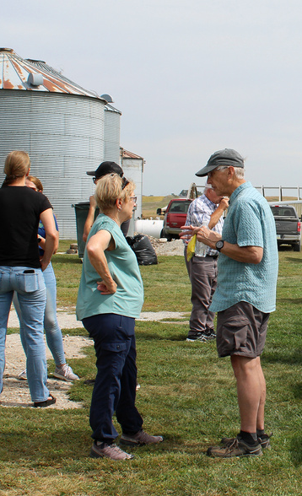
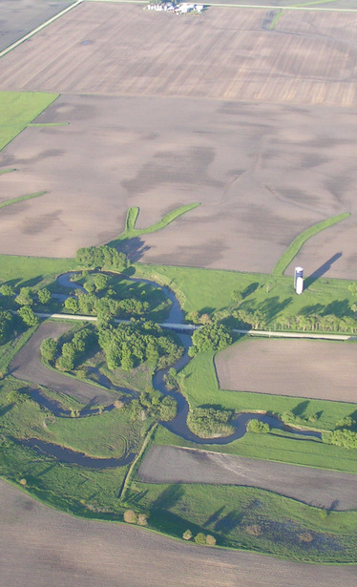
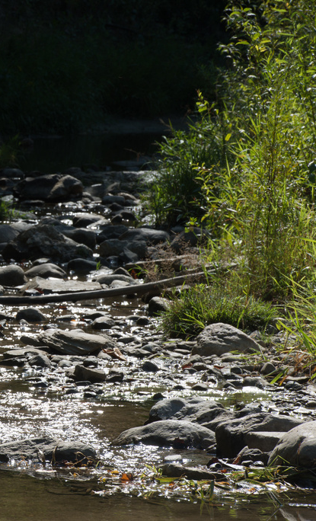
Current initiatives
Conservation Agronomist Network
Conservation Agronomist Training
Farm to River Partnership
Water Monitoring Program
Learn more

Slide 11
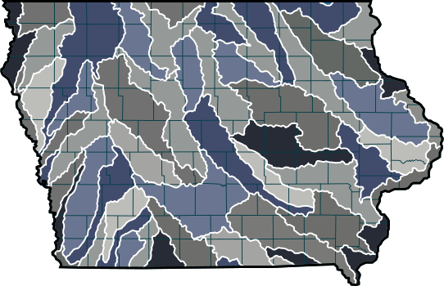
Conservation Agronomist Network
What is a CA? A farmer facing professional
trained in both agronomy and sustainability
to help farmers implement water quality practices that balance environment with profit.
How is ACWA involved? ACWA created the first
CA position in the U.S. and continues to expand the model statewide by strategically finding and funding new roles.
Learn more
3
3
2

Slide 12
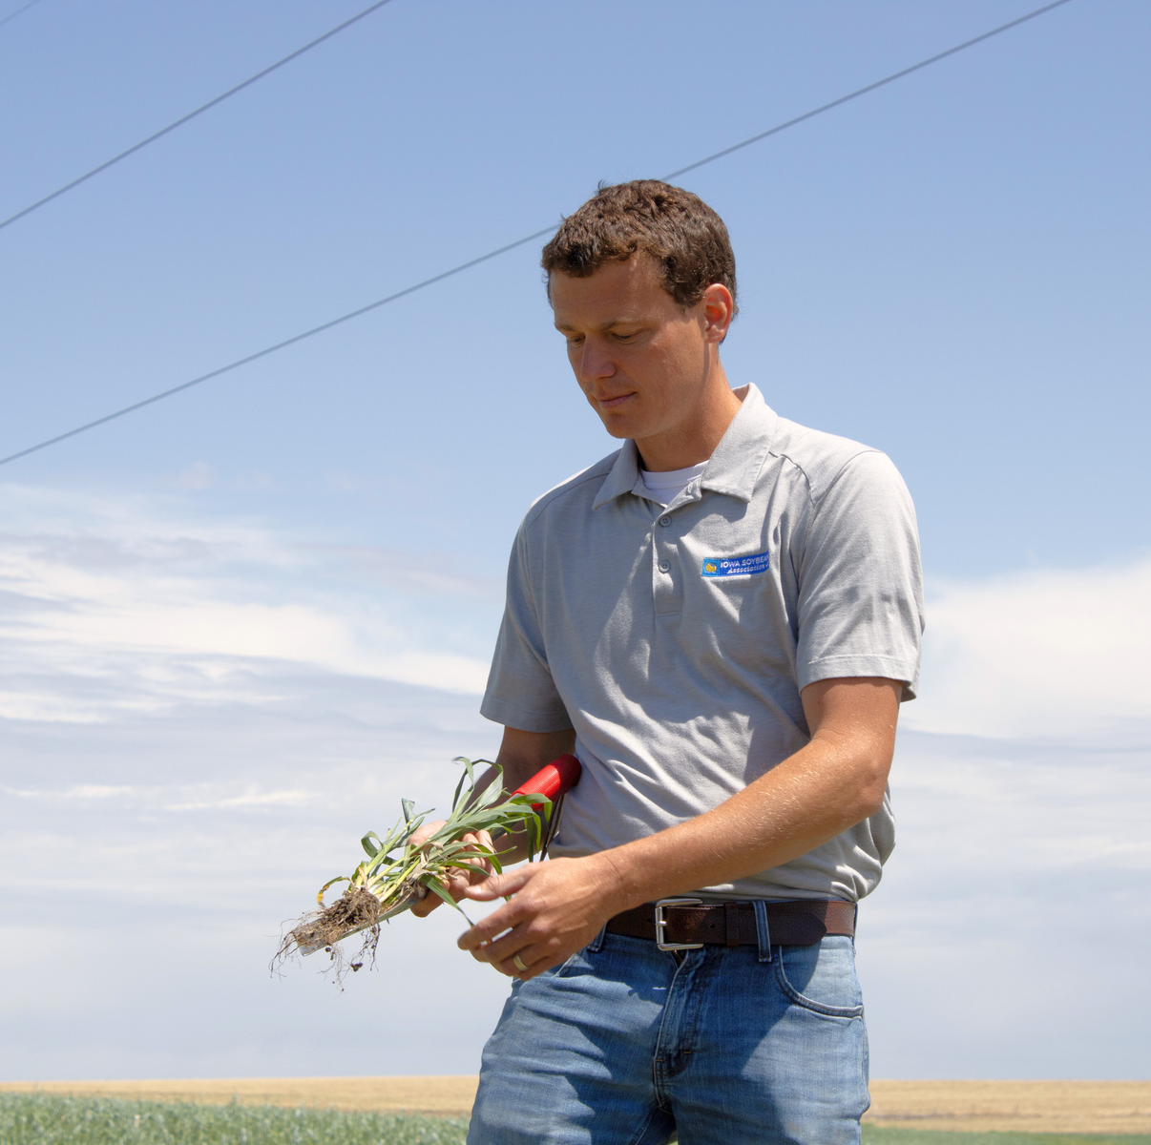
Conservation Agronomist Training
Why is this needed? A conservation agronomist plays a very difficult but rewarding role for ag retailers. They must build strong relationships with farmers and other agronomists. They must “sell” conservation while making sure farmers are ready, comfortable, and have all the tools for success.
How is ACWA involved? ACWA is contracted with Baton Global, a strategy and research firm, to build training modules that will help conservation agronomists be more successful in the field.

Slide 13
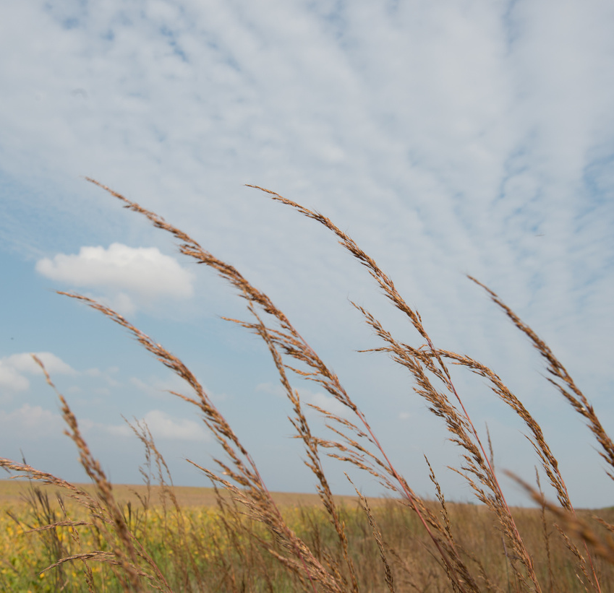
Farm to River Partnership
What is it? It’s a project focused on improving water quality through farmer-led practices in the North Raccoon Watershed. Goals include installing more bioreactors, saturated buffers, wetlands, and expanding cover crops. The project also has a water monitoring component.
Where is it? Sac, Calhoun, Carroll, and Greene counties
How is it funded? A program called the Water Quality Initiative by the Iowa Department of Agriculture and Land Stewardship.
Learn more

Slide 14
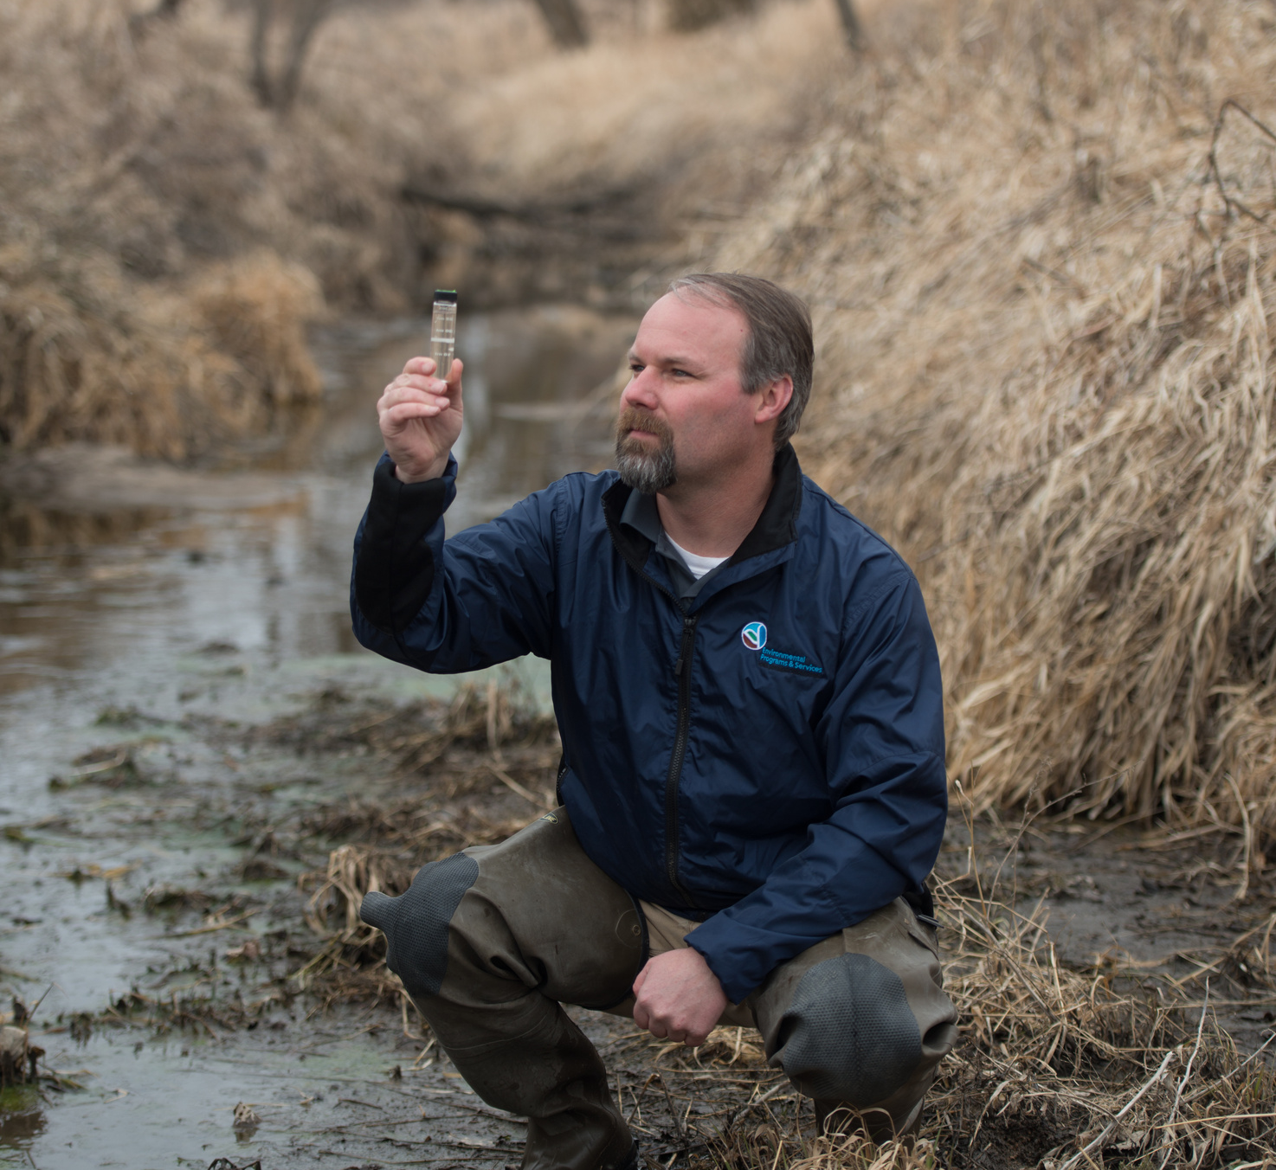
Annual Water Monitoring
How it works - ACWA maintains a thorough database of water quality monitoring data, with an emphasis on nutrients and bacteria.
Why it’s important - Water quality data can guide watershed planning by showing conservationists where to target, it can create a baseline to show changes, and it can track progress as we implement practices.
Where it happens - Our key locations include Beaver Creek, Boone River, and the Raccoon River.
Learn more.

Slide 15
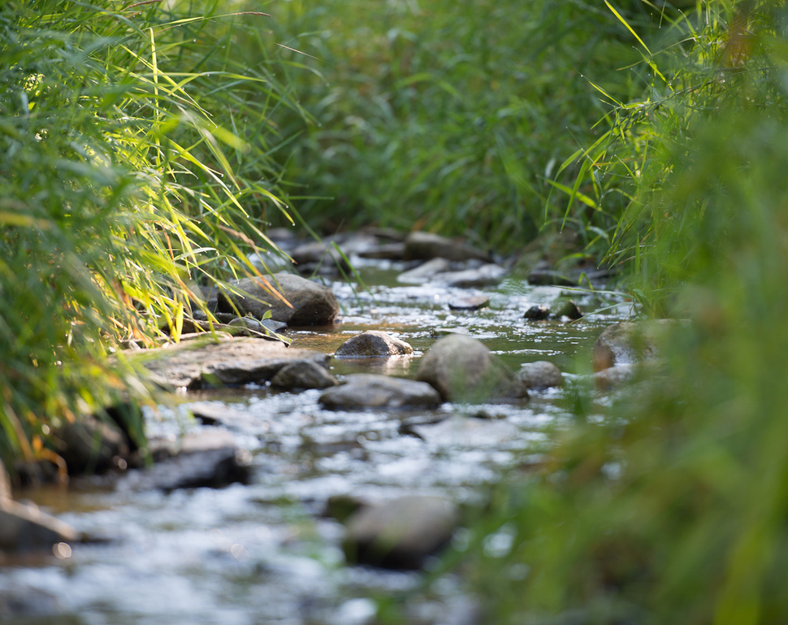
Past projects
ACWA has a 25+ year history of working together to improve water quality.
You can learn about our
previous projects here.

Slide 16
Code of Practice

Slide 17

Code of practice
Purpose: To establish reasonable and practicable guidelines for nitrogen fertilization applications to reduce nitrate loss from farm fields.
Why: Effective management of nutrients on farms in Iowa is one of the keys to enhancing both environmental quality and profitable crop production. Consistent with the Iowa Nutrient Reduction Strategy, this Code of Practice provides information about guidelines adopted by the ACWA members as a condition of membership.
Download here

Slide 18
Click here
for
Key Contacts

